Slide 1
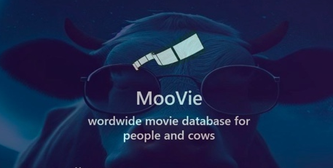
Final Project Movie Database Application
Yam Elgabsi | 208698266

Slide 2
General Structure Our project is divided to two solutions
Server Side | Client Side
C# with ASP.NET Web API is used for building web applications and services. Allows to connect to a SQL Server database, execute SQL queries or commands with HTTP request. | WPF (Windows Presentation Foundation), framework for building desktop applications with user interfaces to use the API functions and display the data..

Slide 3

Technology & Frameworks
Using .NET 7.0 with C#. Entity Framework packages: CORE, TOOLS, SQL SERVER

Slide 4

General Flow
Login screen
Main Window A logged-in user can choose which data to view. My Profile |Companies |Movies | Stars | User (Only for admins)
Search Window
A user can search for a specific model by its name to view it.
A registered user can log into the system using a username and password.
A non-registered user can navigate to the registration screen to sign up for the system.
Model Screen
Each model has a screen that displays its information.
Admin can delete or edit the entity.
Regular users can only edit their own profile information.
Admin can create.

Slide 5
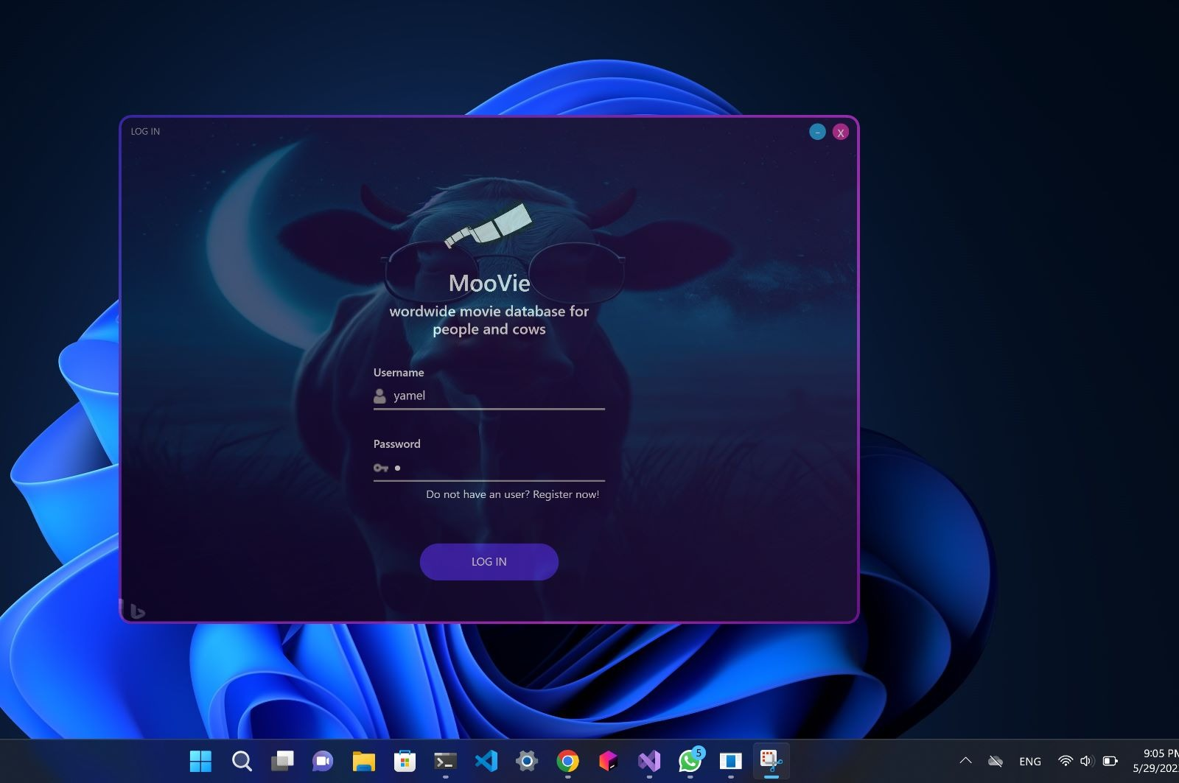
SCREENS

Slide 6
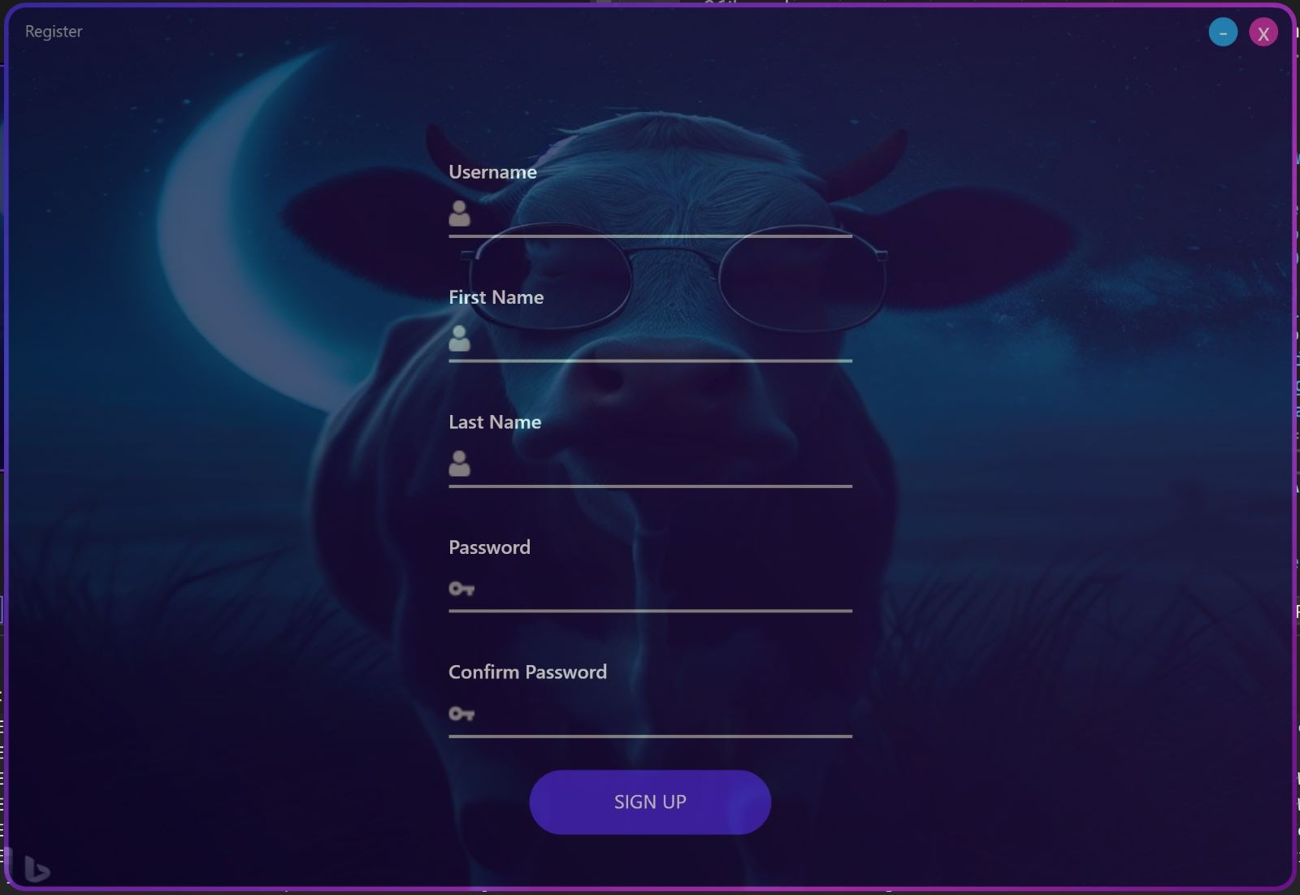
Register Window

Slide 7
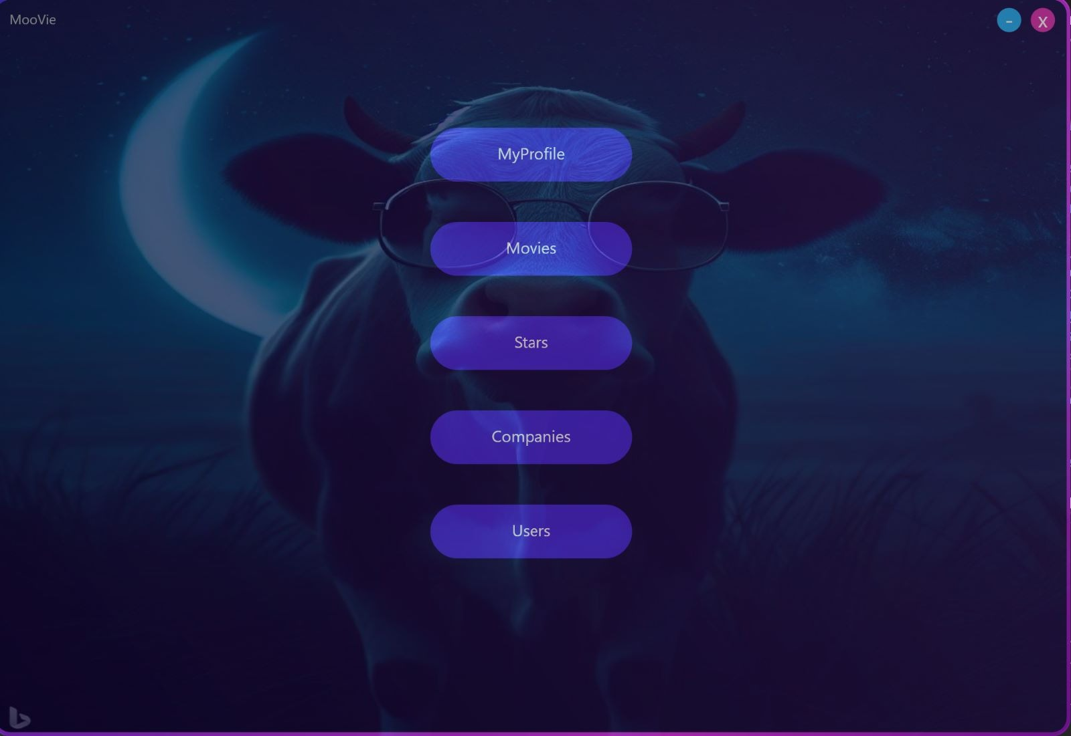
Main Window

Slide 8
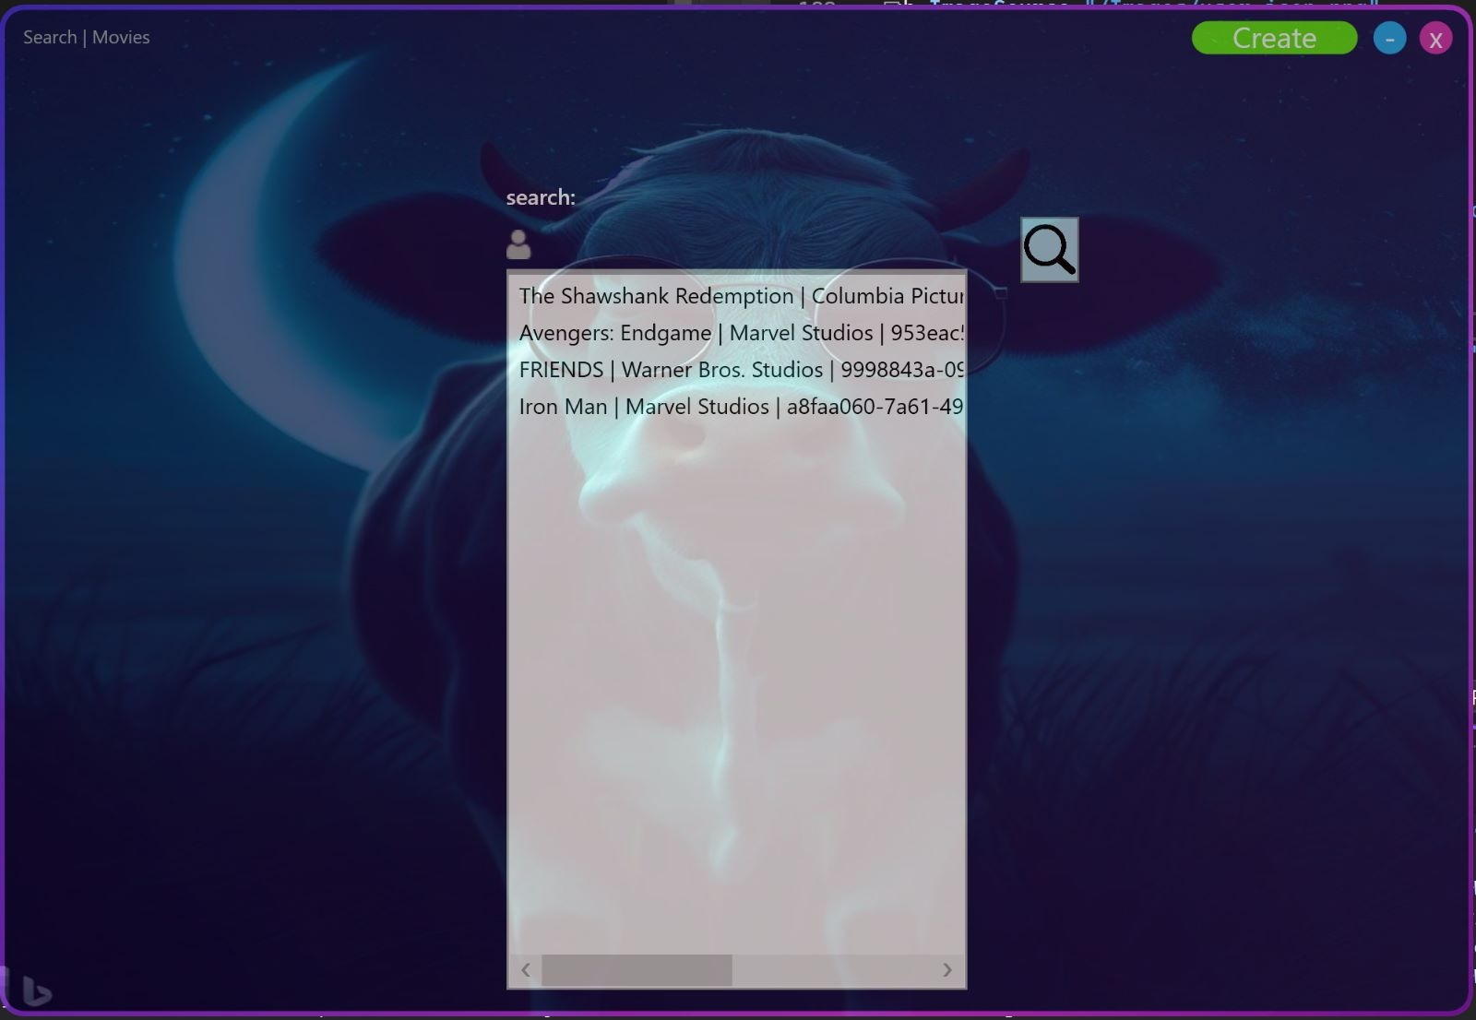
Search Window

Slide 9
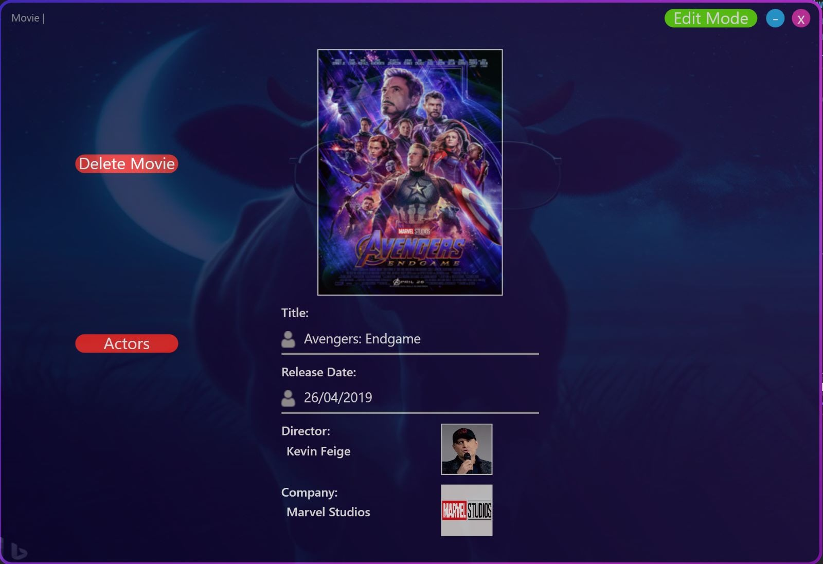
Movie Window

Slide 10
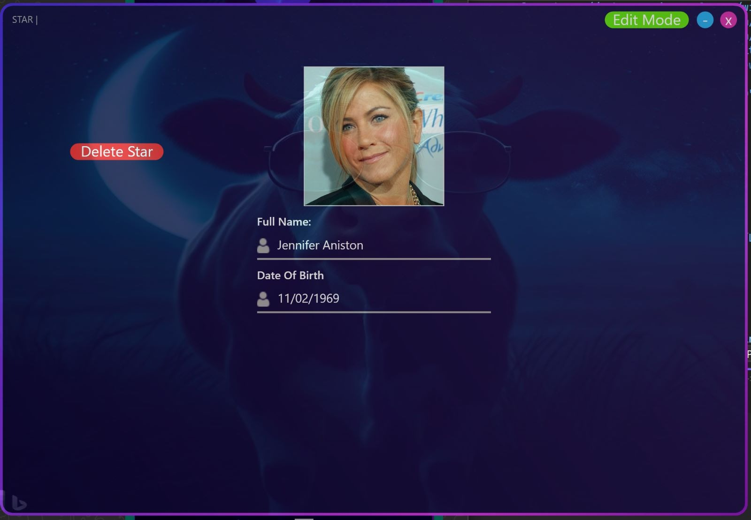
Star Window

Slide 11
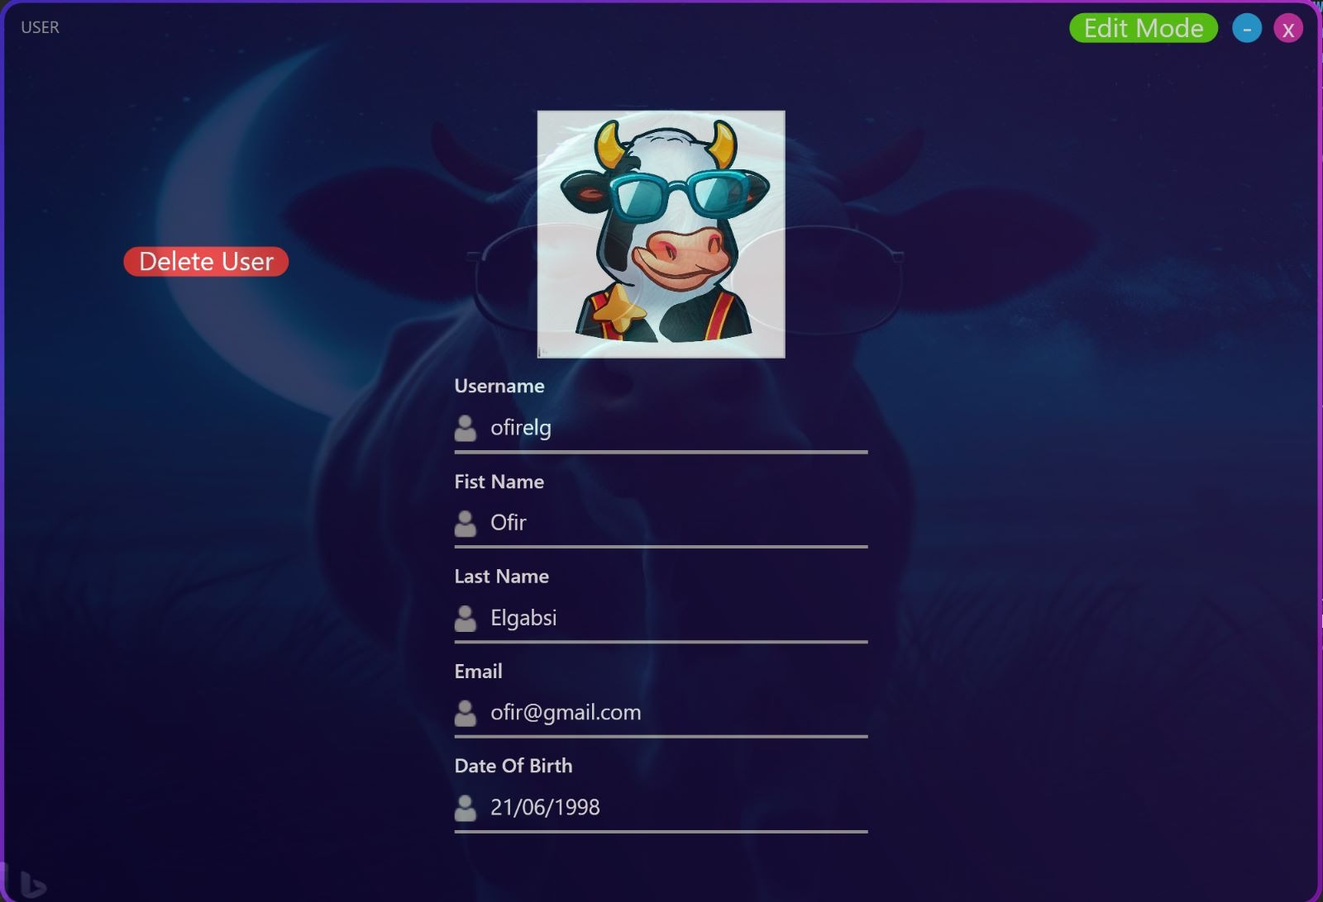
User Window

Slide 12
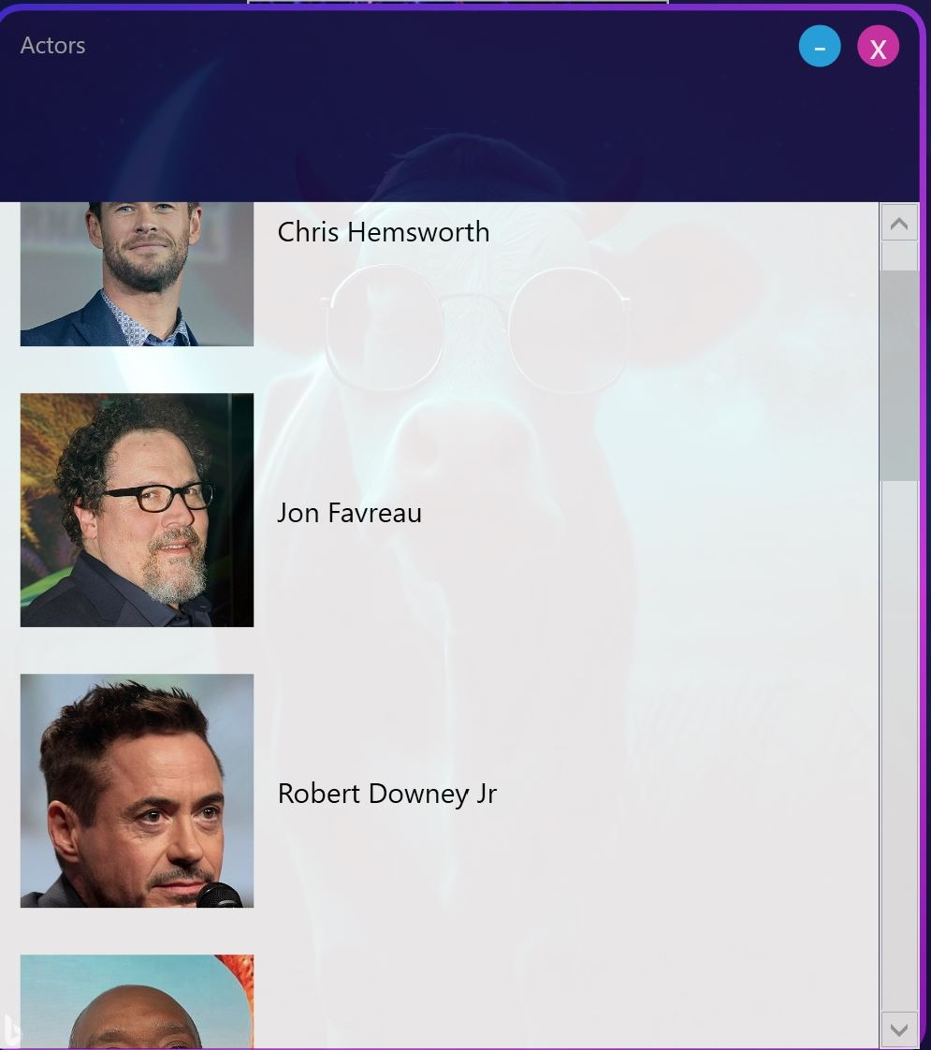
Actors Window

Slide 13
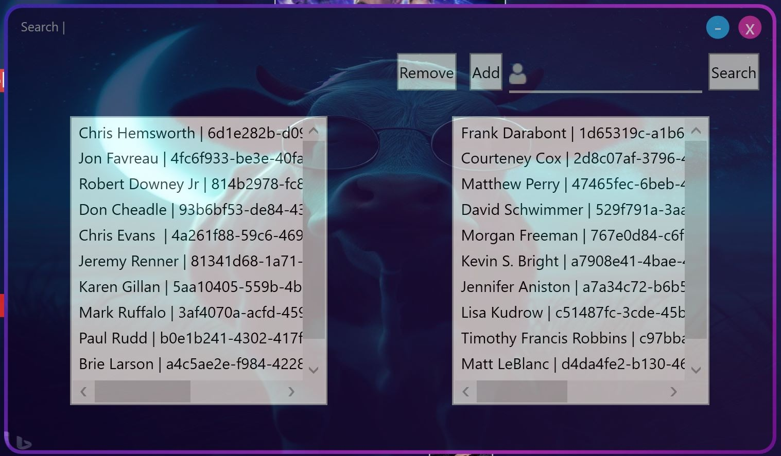
Actor MiniWindow

Slide 14
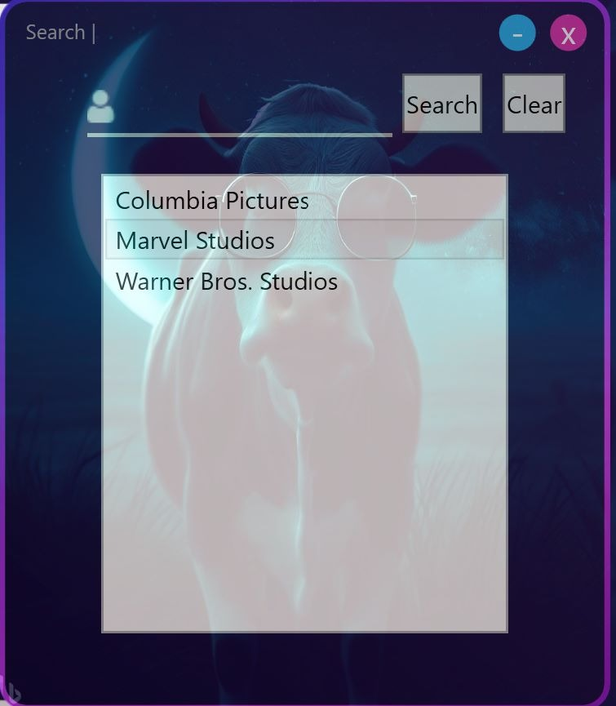
Company MiniWindow

Slide 15
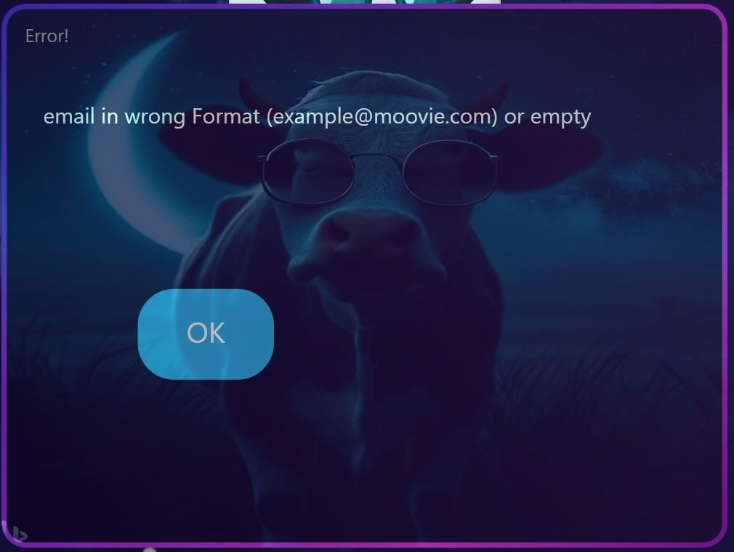
Error MiniWindow

Slide 16
Models
User
string username
string FirstName
string LastName
string Image
string Email
string Password
DateTime DateOfBirth
Bool IsAdmin
Star
string Id
string Name
String Image
DateTime DateOfBirth
Movie
string Id
string Title
string Director_Id
string Companey
DateTime ReleseDate
Company
string Name
String Logo
DateTime Founded

Slide 17
helper Model
MovieStar
string MovieStarId
string MovieId
string StarId
UserService
private static readonly UserService instance = new UserService();
private static readonly HttpClient httpClient;
private static readonly string baseUrl = "https://localhost:7206";

Slide 18
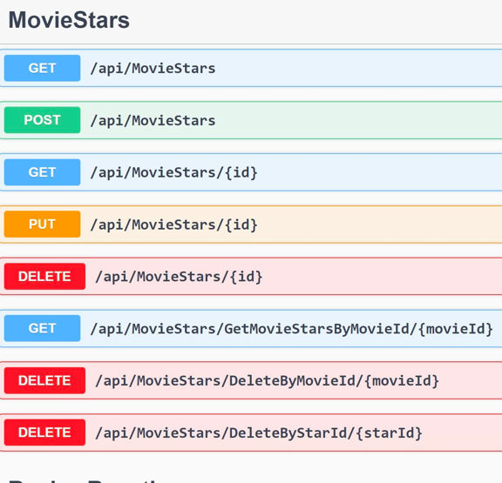
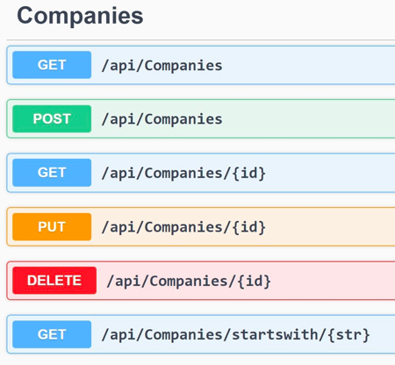
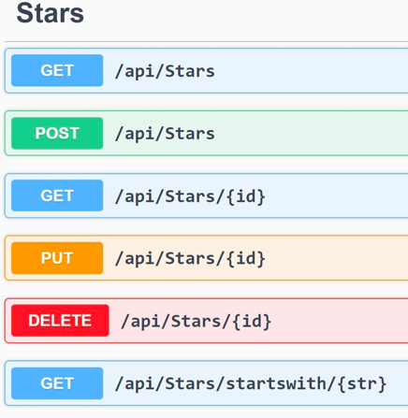
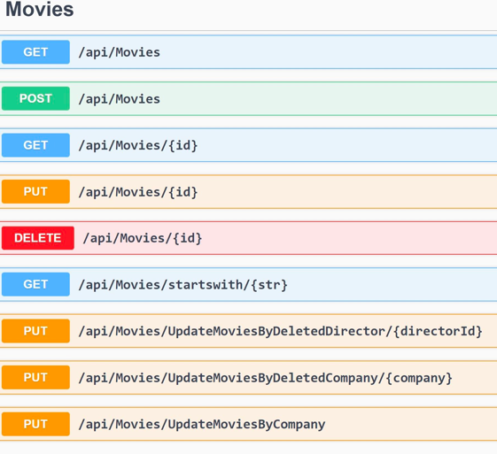
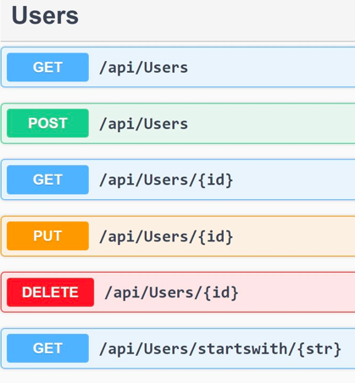
API Functions

Slide 19

Whats Next?
The project contains basic information about movies, and it will be possible to expand the data, such as adding an option for TV series in addition to movies, movie duration, directors, producers (not just one), genre, language, actor's role name in the movie, and a wide range of other information.
The project can serve as a foundation for a broader project, such as a movie review application, a movie streaming application, a movie store application, and a cinema application for booking tickets.
Expanding the platforms - The project is currently an application for computers with the Windows operating system, so it will be possible to expand and build user systems using the API on a wider range of platforms such as web, Android, iOS, and more.

Slide 20

Thanks

